Slide 1
BASTA HOTEL
Hotel reservation and Booking System
CREATED BY:
ARZADON, CHRISTIAN ANDREI T.
DOMINGO, FRITZJERALD L.
GUMABAY, CARL JOHN

Slide 2
intoduction
Welcome to Basta Hotel, where your comfort is our priority. Our Reservation and Booking System is designed to provide you with a seamless experience from the moment you plan your trip to the day you check out. With our user-friendly interface and comprehensive features, managing your hotel bookings.
Basta Hotel Reservation and Booking System offers a range of functionalities tailored to meet your needs. Whether you're a guest looking to book a room our system is equipped to handle it all. From real-time availability checks to secure payment processing, we ensure that every step of your booking process is efficient and reliable.

Slide 3
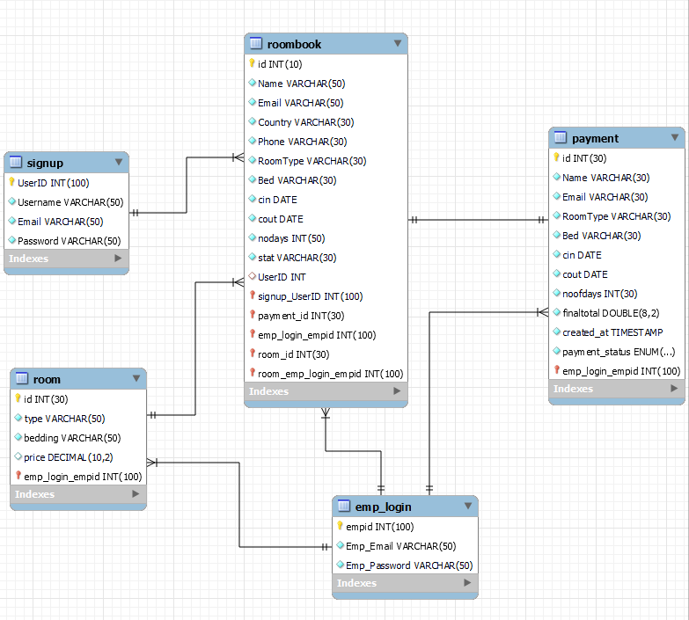
Entity relationship model

Slide 4
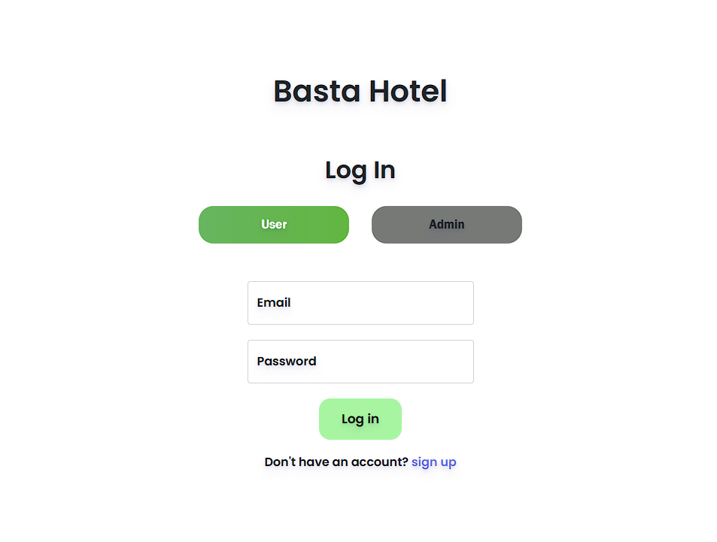
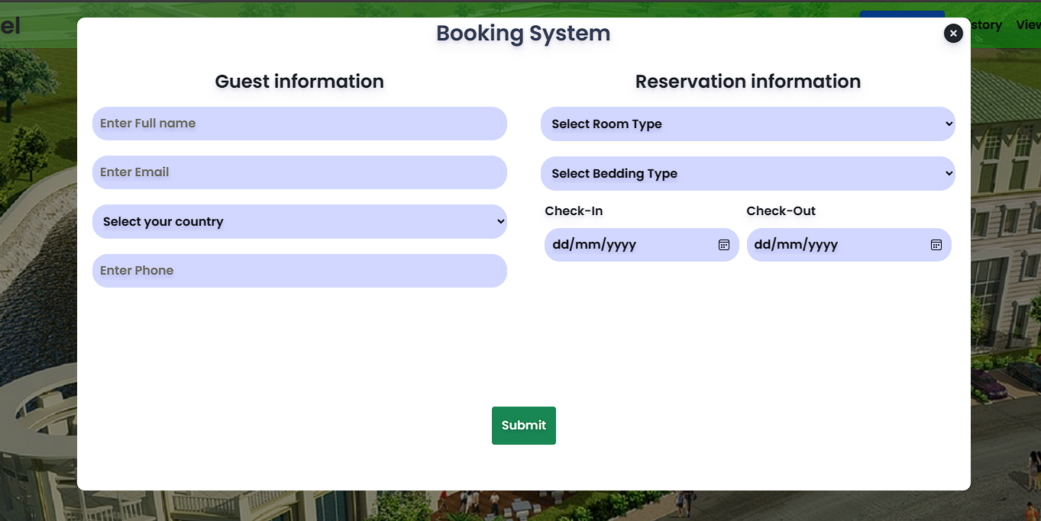
CUSTOMER UI LOGIN ROOMBOOKING

Slide 5
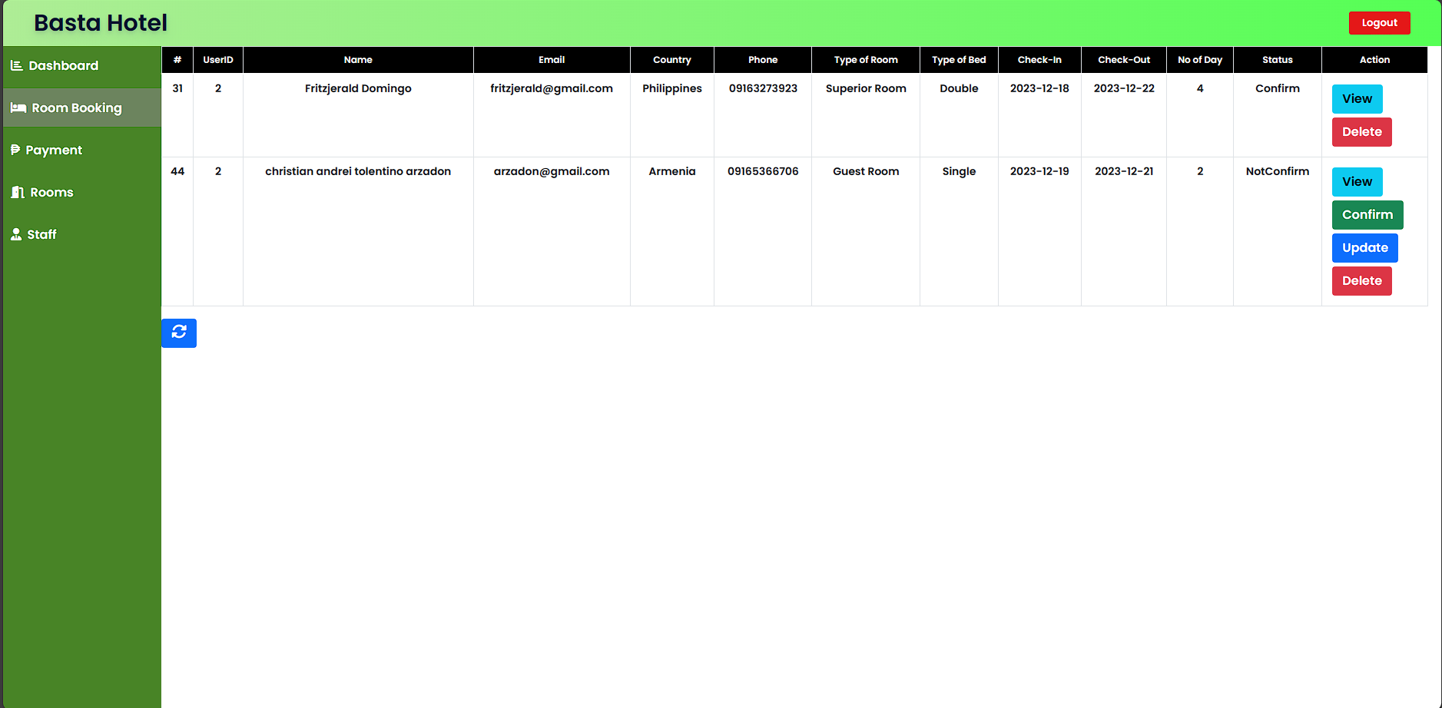
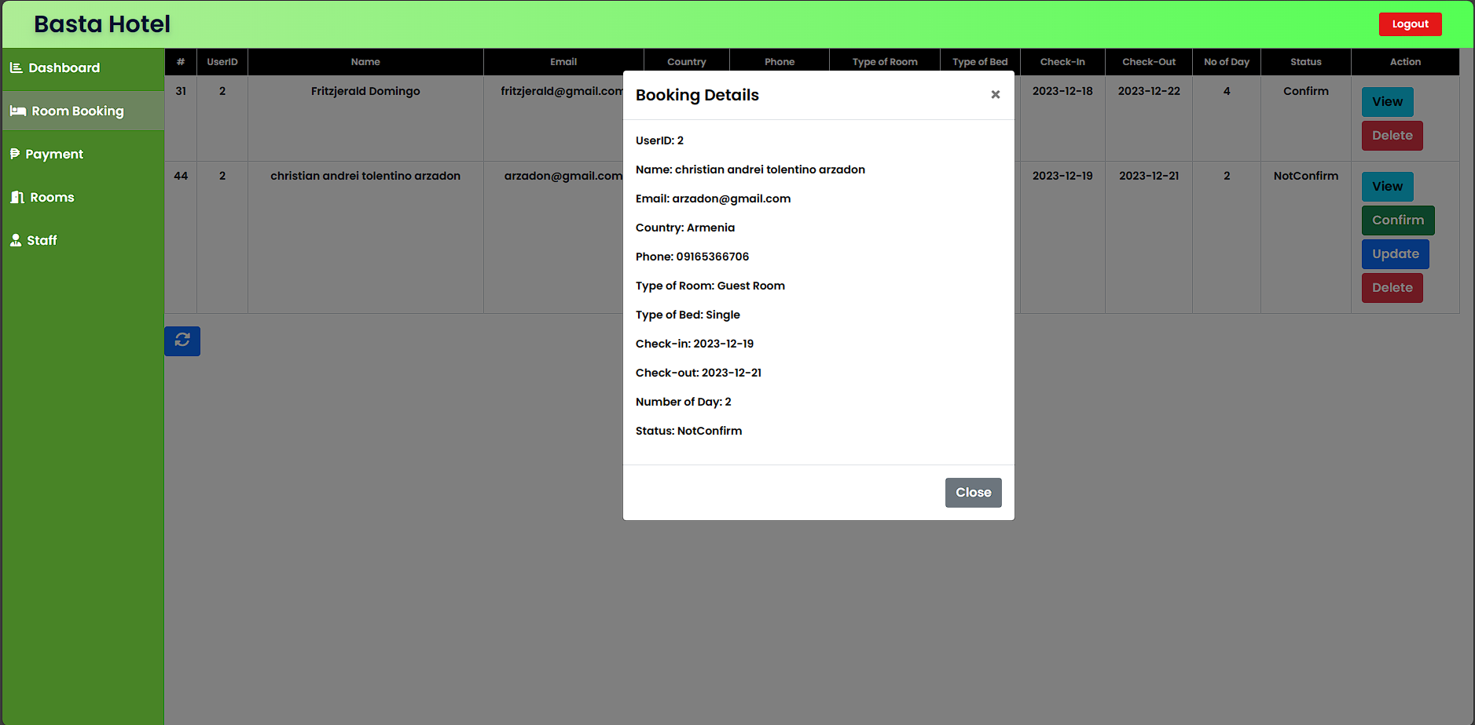
ADMIN

